Slide 1
Introduction to algorithm
Algorithm and programming

Slide 2
Learning Objectives
At the end of this session, student will be able to:
LO-1 : explain kind of algorithms in problem solving

Slide 3
Subtopics
Algorithm
Algorithm Development Steps
Pseudo-code
Flow Chart
Structured Theorem
Exercise

Slide 4
Algorithm
Definition
Algorithm is a step-by-step procedure for solving a problem, clearly defining the actions to be performed and the order in which they should be executed.
In the programming domain, algorithm define as a structured method used to solve a problem using a computer, often written as a series of logical steps or instructions.
Simple algorithm Example:
  Add Two Numbers Algorithm
  Input the first number → A
  Input the second number → B
  Add A and B, store the result in SUM
  Display SUM

Slide 5
Algorithm
Simple algorithm example
People may follow different steps (algorithms) to solve the same problem. As long as the result is correct, each algorithm is valid.
Let’s look at two example algorithms for calculating the average of 3 numbers:
  Algorithm 1:
  Read temperature A
  Read temperature B
  Read temperature C
  Compute average = (A + B + C) / 3
  Display average
  Algorithm 2:
  Read all three temperatures together
  Store them as A, B, and C
  Compute sum = A + B + C
  Compute average = sum / 3
  Display average

Slide 6
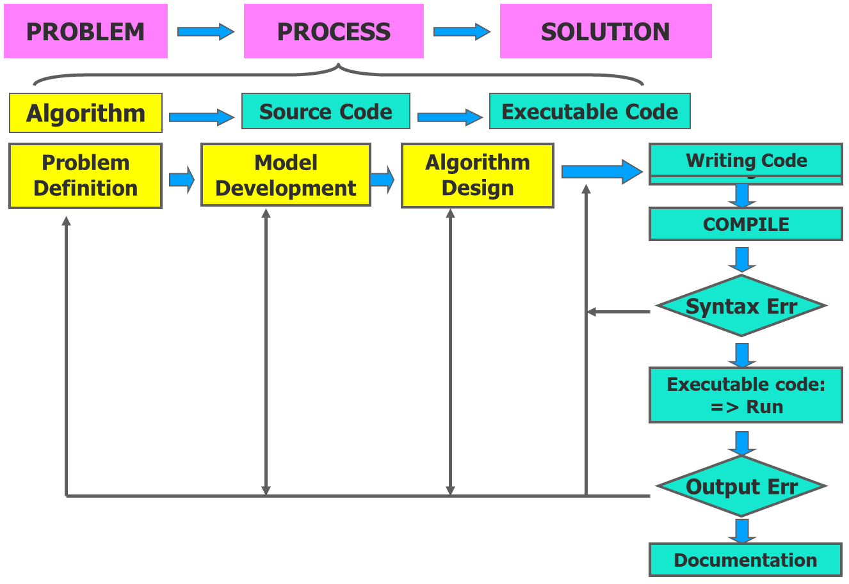
Algorithm
Good Algorithm Practice
Having the right logical flow to solve the problem
Producing the correct output in a time efficient manner
Written using unambiguous structured language
Easy implementation into real programming language
All steps and operations are clearly defined and ended

Slide 7
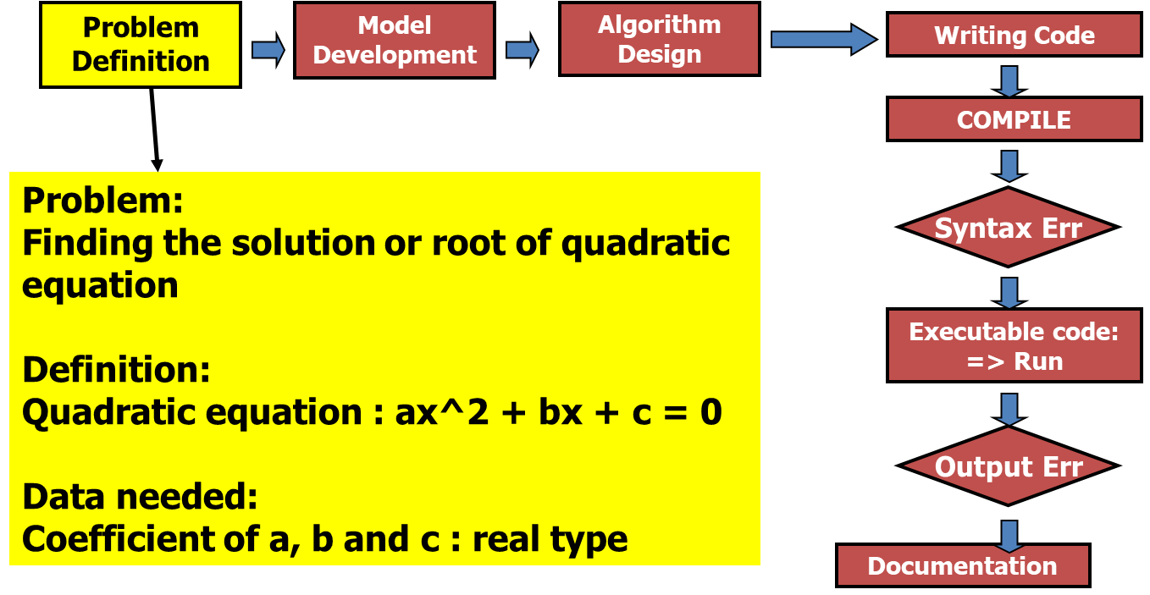
Algorithm DEVELOPMENT STEPS
Problem Definition

Slide 8
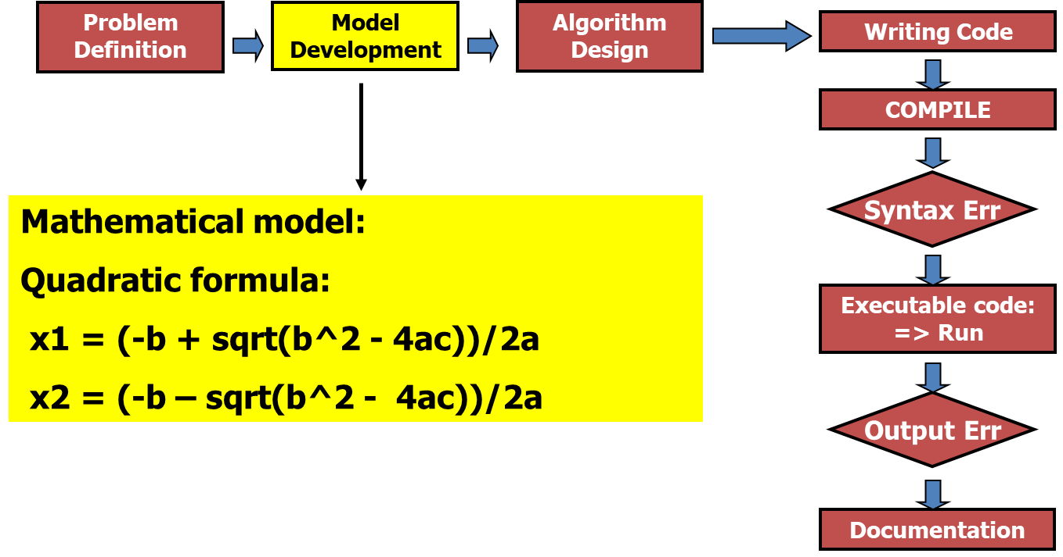
Algorithm DEVELOPMENT STEPS
MODEL DEVELOPMENT

Slide 9
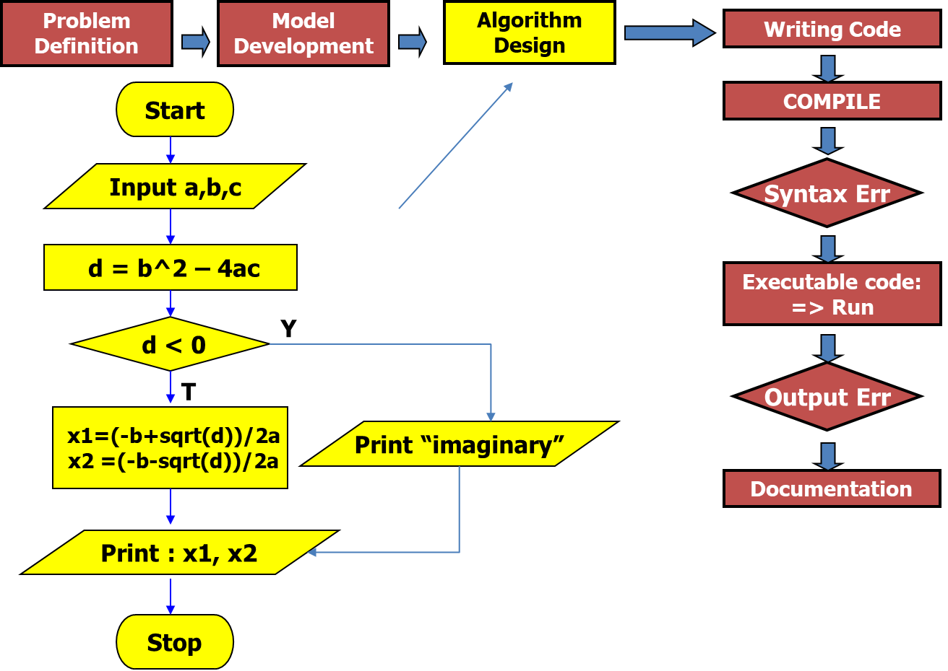
Algorithm DEVELOPMENT STEPS
ALGORITHM DESIGN

Slide 10
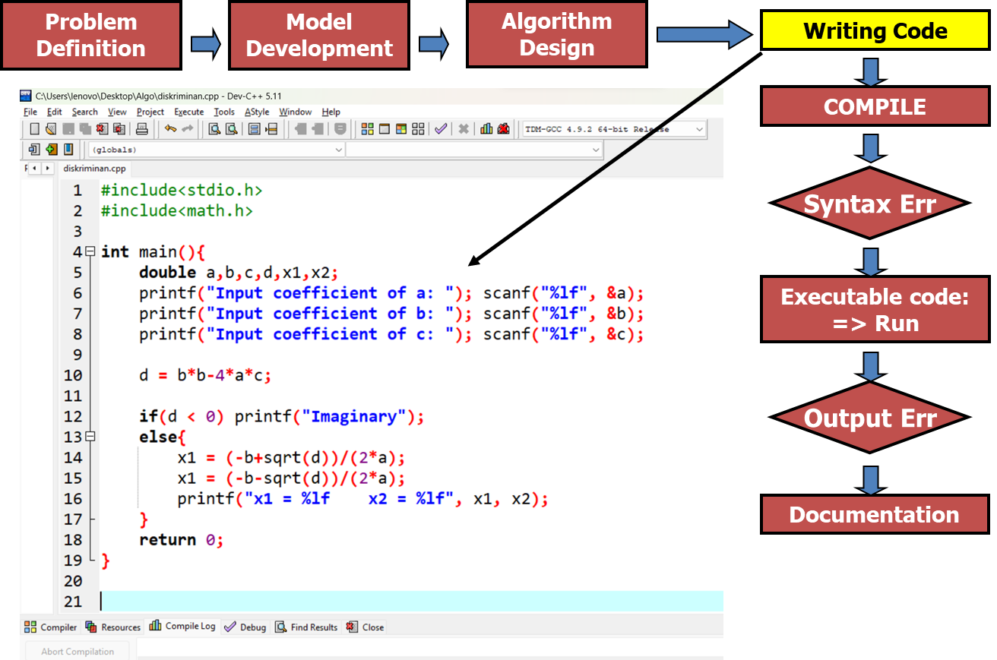
Algorithm DEVELOPMENT STEPS
WRITING CODE

Slide 11
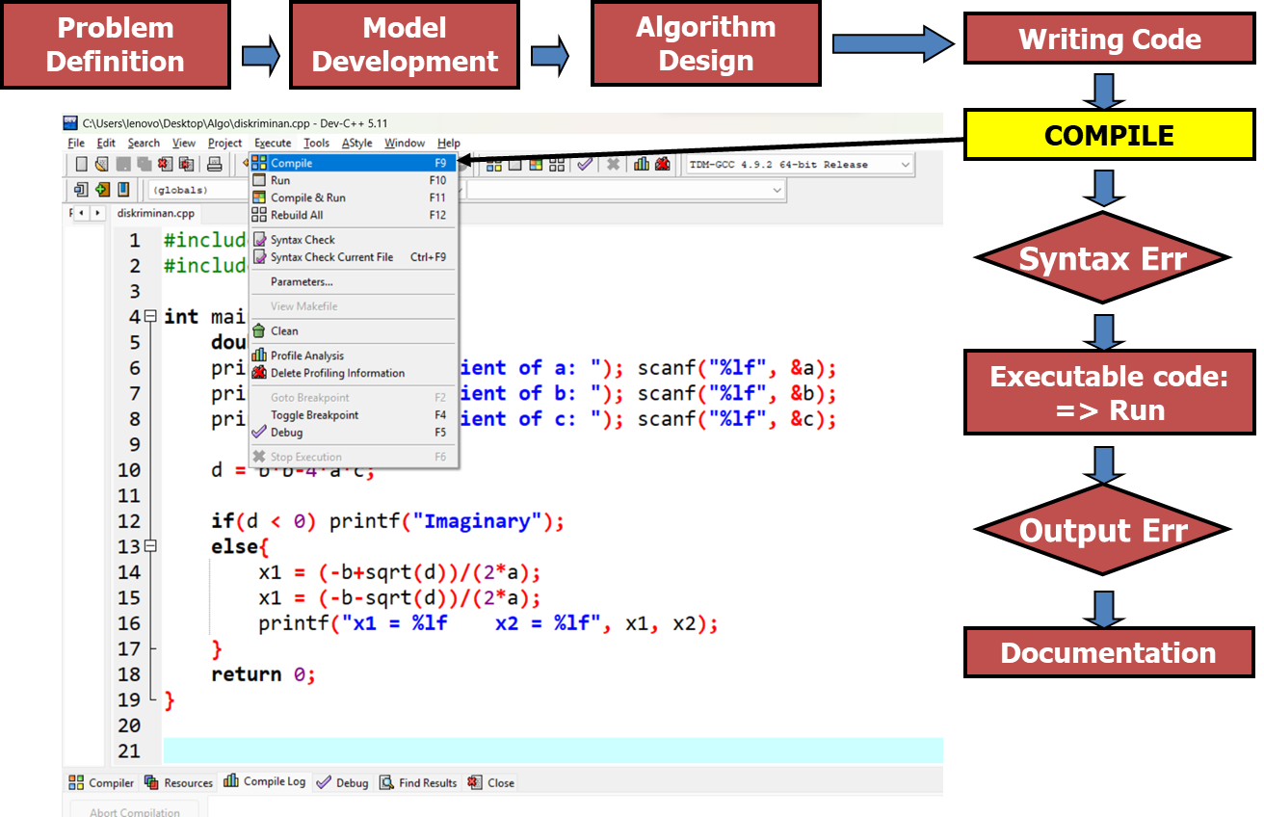
Algorithm DEVELOPMENT STEPS
COMPILE

Slide 12
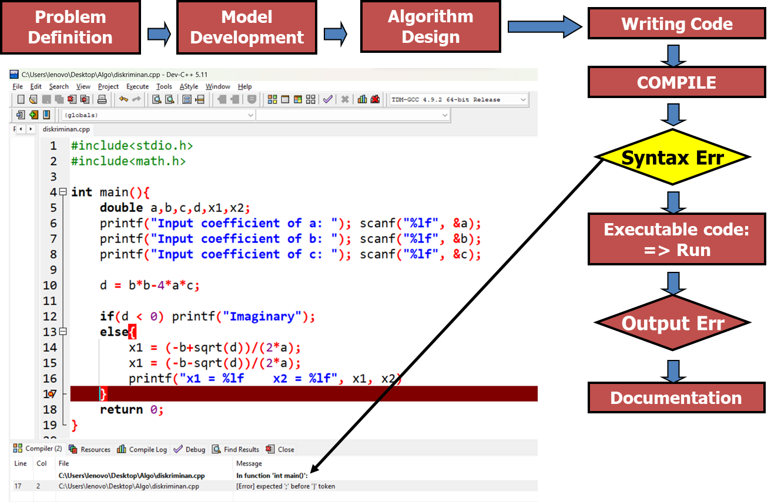
Algorithm DEVELOPMENT STEPS
SYNTAX ERROR

Slide 13
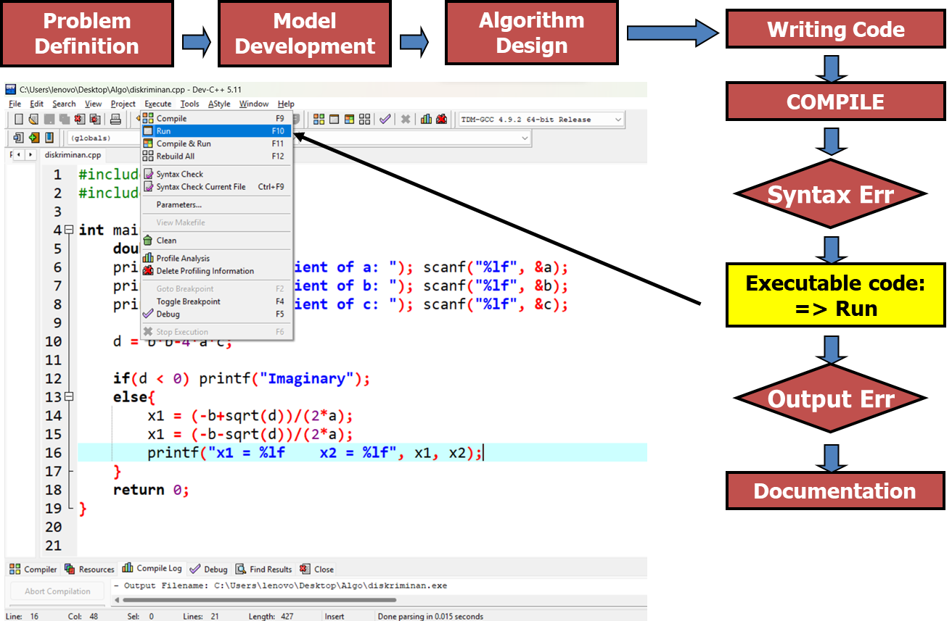
Algorithm DEVELOPMENT STEPS
RUN CODE

Slide 14
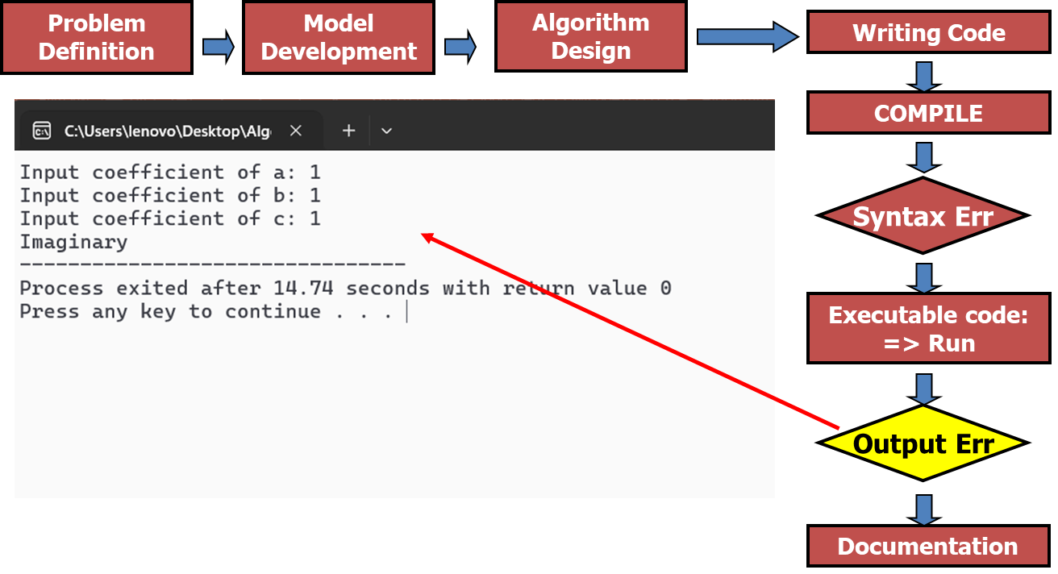
Algorithm DEVELOPMENT STEPS
OUTPUT ERROR

Slide 15
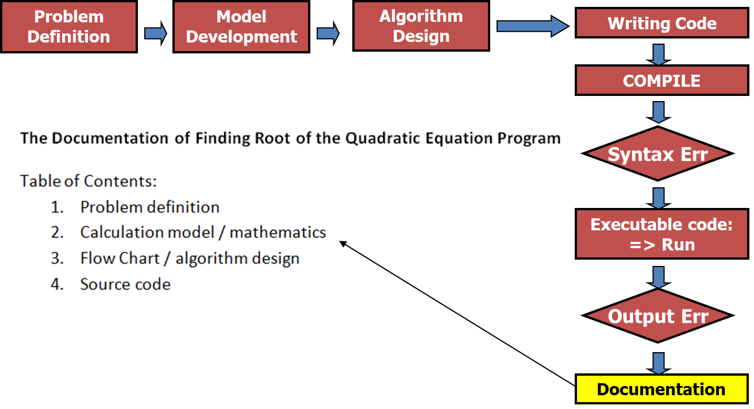
Algorithm DEVELOPMENT STEPS
DOCUMENTATION

Slide 16
Algorithm
Representing algorithm
To develop and represent an algorithm clearly, we can use:
Writing
  Structured English
  Pseudocode
  A step-by-step description of the algorithm that resembles a programming language but is not actual code. It uses simple English-like instructions for each step.
2. Drawing
  Flowchart
  A diagrammatic representation of an algorithm that uses symbols and arrows to depict the flow of control.

Slide 17
Pseudocode
definition
Pseudocode is an artificial and informal language used to design and describe algorithms before writing actual code.
It focuses on logic and not bound by the syntax of any specific language, making it flexible and easy to read.
Pseudocode uses everyday language and simple keywords to describe control structure.
Example of common keywords:
Operations | Example Keywords
Input | read, get
Output | print, display
Storing value | set, store
Decision (Selection) | if … else
Repetition (Loop) | While, for
Compute | calculate, add, subtract, multiply, divide

Slide 18
Pseudocode
INPUT
Statements can be used when a computer receive information or input:
Read, Get, Input or Key-In
Example:
  Read bilangan
  Get tax_code
  Baca students_name

Slide 19
Pseudocode
OUTPUT
Statements can be used when a computer displaying information or output:
Print, Write, Put, Output, or Display
Example:
  Print “Bina Nusantara University”
  Write “Algorithm and Programming”
  Output Total

Slide 20
Pseudocode
Compute
To do arithmetic calculation the following operators are used:
+ (add)
- (subtract)
* (multiply)
/ (divide)
() (scope)
Statement Compute, Calculate or Add also can be used
Example:
Add number to total
Total = Total + number

Slide 21
Pseudocode
Store
There are three ways of storing value into a variable:
Initializing value using statement Initialize or Set
Storing value as calculation result using =
To simply store a value into a variable using “Save” or Store
Example:
Set Counter to 0
Total = Price * Qty

Slide 22
Pseudocode
Decision (SELECTION)
One of the main operation in computing is comparing values and choosing options based on its result
Keyword used: IF, THEN and ELSE
Example:
IF Menu=‘1’ THEN
  Discount = 0.1 * price
ELSE
  Discount = 0.2 * price
ENDIF

Slide 23
Pseudocode
Repetition (Looping)
To repeat an action/step, we use keyword DOWHILE and ENDDO
Example:
DOWHILE number < 10
print number
number = number +1
ENDDO

Slide 24
Pseudocode
example
Example 1:
Algorithm using a calculator to sum values
Start
Set the calculator ON
Empty any values
Do
  Input price
  Push plus button (+)
While all prices have been input
Print total price
Set the calculator OFF
End
Example 2:
Algorithm to count average score of 10 students
Start
Set total = 0
Set grade counter = 1
While grade counter is less than or equal to 10
  Input next score
  Add score into total
  Add 1 to grade counter
Set class average = total/10
Print the class average
End

Slide 25
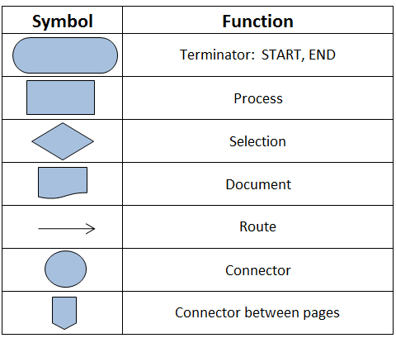
flowchart
symbol

Slide 26
flowchart
example
Start
Input a,b,c
d = b^2 – 4ac
d < 0
Y
Algorithm to Solve a Quadratic Equation Using the Discriminant
T
x1=(-b+sqrt(d))/2a
x2 =(-b-sqrt(d))/2a
Print message
“Imaginary”
Print: x1, x2
Stop

Slide 27
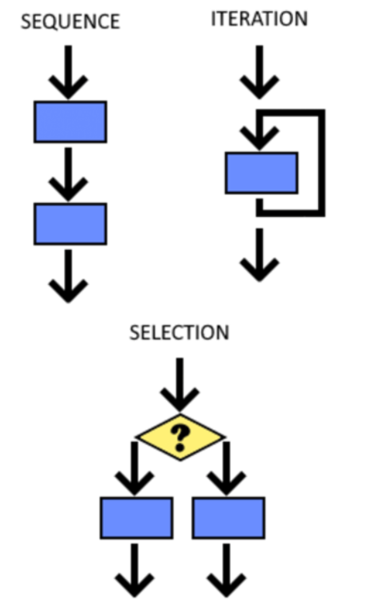
Structure Theorem
definition
Any computer program can be constructed using only three control structures:
Sequence
  A sequence is a series of consecutive commands or statement.
  Most programming languages execute statements in order, from the top of the program to the bottom.
Selection
  The selection structure allows a program to choose between different paths based on a condition.
  If the condition is true, one block of code executes; otherwise, another (optional) block may run.
Repetition (iteration)
  Repetition enables a block of statements to be executed multiple times.
  The loop continues as long as a specified condition remains true.

Slide 28
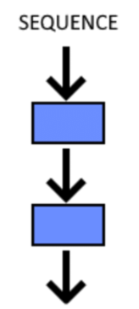
Structure Theorem
Sequence
Sequence is series of consecutive commands/statements
Commonly programming language has sequence of statements flowing from top of the program to its end
Example :
Print “Number of students:”
Set total to 49
Print “Add new student:”
Read newStudent
total = total + newStudent
Print “Number of students:”
Print total
Description
Sequence of command is from the 1st line to the end of code.
If newStudent input is 2 then total that later on printed out is 51

Slide 29
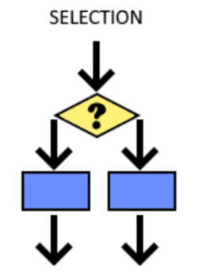
Structure Theorem
SELECTION
Selection control structure is structure that allow us to choose from several options of statement/command
The first statement will be executed if the condition is satisfied, if not then the else statement will be executed (if the other exist)
Example :
IF Day=1 THEN
Print “Monday”
ELSE
Print “Obviously not Monday”
Description
The word “Monday” will be printed out if Day’s value equal to 1, else it will print out the sentence “Obviously not Monday”.

Slide 30
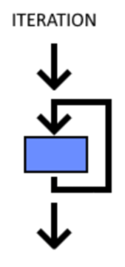
Structure Theorem
Repetition
A number of statements/commands can be repeated several times using Repetition structure control
Statements/commands will be repeated while the looping condition is satisfied (may use DOWHILE – ENDDO)
Example :
Stars = 0
DOWHILE Stars < 5
Print Stars
Stars = Stars + 1
ENDDO
Description
At first Stars’ value equals to 0, after following the DOWHILE looping Stars’ value will be updated 5 times resulting:
0 1 2 3 4

Slide 31
EXERCISE
1. Using the Pseudo-code, create:
  an algorithm to calculate a rectangle area!
  an algorithm to change second into hour and minute unit!
  an algorithm to decide whether an input number is an odd or even number!
  an algorithm to calculate a circle area!
  an algorithm to accept three numbers and find the max number!
2. Repeat no. 1 using Flow Chart

Slide 32
SUMMARY
Algorithm is a procedure for solving a problem in terms of the actions to be executed
Algorithm development steps consists of problem definition, model development, algorithm design, writing code, and documentation
We can use writing (Structure English and Pseudo-code) or drawing (Flow Chart) to represent algorithm
Basic Computer Operation: input, output, compute, store, compare (selection), and repetition (loop)
Structure theorem are sequence, selection, and repetition

Slide 33
REFRENCES
Paul Deitel & Harvey Deitel. (2021). C how to program. 09. Pearson Education. New York. ISBN: 9780137398393.
Jeri R. Hanly , Elliot B. Koffman. (2016). Problem Solving and Program Design in C. 08. ISBN: 9781292098814
Writing Your First C Program: http://aelinik.free.fr/c/ch02.htm
Data Types and Names in C: http://aelinik.free.fr/c/ch04.htm
Structure theorem: https://www.researchgate.net/figure/Control-structures-sequence-selection-and-iteration_fig1_350413038

